Slide 1
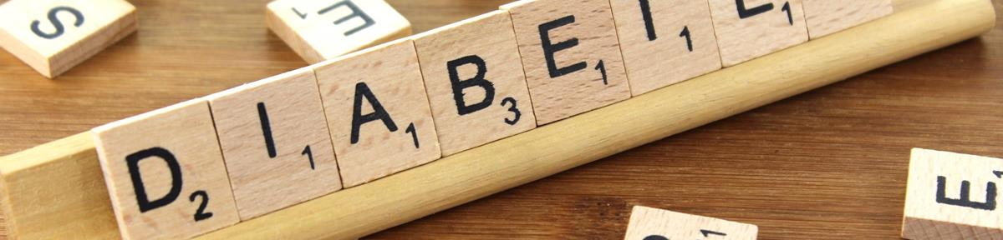
Diabetes Detection Using Machine Learning
PROJECT MENTOR:
Prof. Arnab Chakraborty
TEAM MEMBERS:
AQDAS SULTAN, ECE DEPT. , 3RD YEAR
ALTAMASH AHMAD, ECE DEPT. , 3RD YEAR
SHIVAM PANDEY, ECE DEPT. , 3RD YEAR
ANAS TANWEER,ECE DEPT. , 3RD YEAR
This Photo by Unknown Author is licensed under CC BY-SA

Slide 2
CONTENTS
Project Objective & Scope
Data Description
Methodology
Data Preprocessing
Models Used
Accuracy Comparison
Inference
Future Scope of Improvements

Slide 3
Objective & Scope:
Objective :
Goal: Develop a predictive model to determine diabetes presence using patient medical records.
Approach: Analyze key health metrics like glucose levels, BMI, and insulin to identify patterns linked to diabetes.
Outcome: Enable early detection of diabetes for timely intervention and improved healthcare efficiency.
Scope :
Early Detection: Facilitate timely diagnosis of diabetes to prevent severe complications.
Healthcare Efficiency: Support medical professionals with automated, data-driven predictions.
Scalability: Adaptable for large-scale use in hospitals and community health programs.

Slide 4
Data Preprocessing
1. Missing values for critical columns (Glucose, BloodPressure, SkinThickness, Insulin, BMI) were replaced with NaN.
2. Missing values were filled using the median of each column to retain data integrity.
3. Features were separated (X) from the target variable (y - Outcome).
4. The dataset was split into training (80%) and test (20%) sets.

Slide 5
Model Building: Logistic Regression
1. Logistic Regression was chosen for its simplicity and interpretability.
2. The model was trained on the training set with 1000 iterations.
3. Predictions were made on the test set to evaluate performance.

Slide 6
Evaluation Metrics
1. Accuracy: The percentage of correct predictions made by the model.
2. ROC-AUC Score: Measures the model's ability to distinguish between classes.
3. Classification Report: Provides precision, recall, and F1-score for each class.

Slide 7
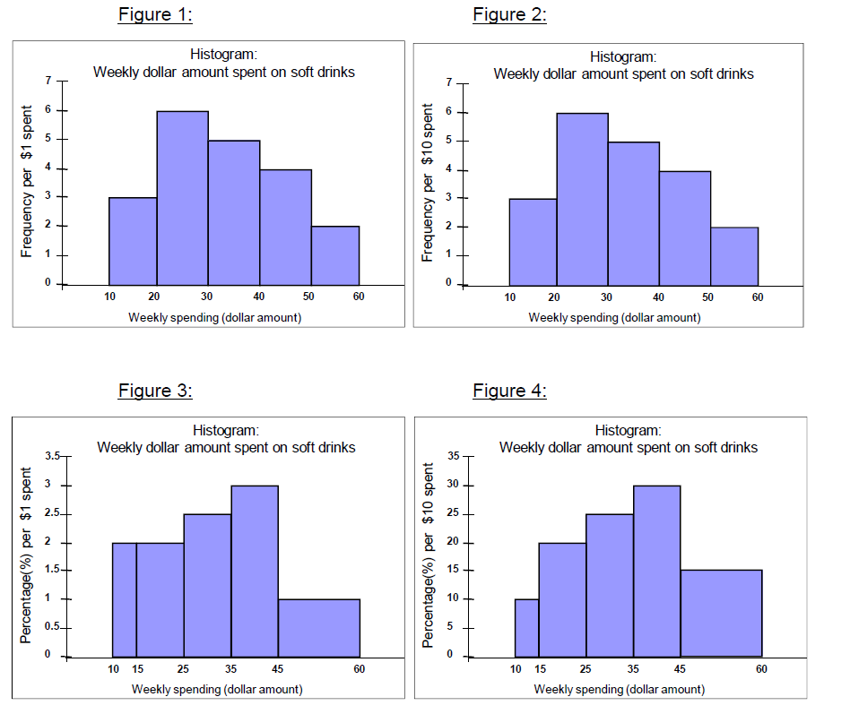
Visualization: Feature Distributions
Histograms were plotted for each feature to understand their distributions.
This Photo by Unknown Author is licensed under CC BY-SA

Slide 8
Visualization: Correlation Heatmap
A heatmap was created to visualize correlations among features. This helps in identifying multicollinearity and key relationships.

Slide 9
Visualization: ROC Curve
The ROC curve illustrates the trade-off between True Positive Rate (TPR) and False Positive Rate (FPR) at different thresholds. The AUC value summarizes the curve.

Slide 10
Insights & Inferences
1. Glucose and BMI emerged as significant predictors of diabetes.
2. The model achieved an accuracy of approximately 80%, indicating reliable performance.
3. The ROC-AUC score of 0.85 suggests good discriminative ability.

Slide 11
Future Improvements
1. Include more features such as family history or genetic data.
2. Experiment with advanced algorithms like Random Forest or XGBoost.
3. Optimize the model further using hyperparameter tuning.
4. Validate the model on external datasets to ensure generalizability.

Slide 12

Thank you
anastanweer786@gmail.com
aqdassultan1644@gmail.com
altamashahmed817@gmail.com
shivampandeyvrn@gmail.com

